Slide 1
Gesture Based UI
Arjun Kharel
John Walsh

Slide 2
PURPOSE OF THE APPLICATION
The purpose of this application is to demonstrate and implement the various gesture controls. We have created a Robot using Arduino and controlled it using armband. We have also developed an android app that allows user to control the movement of the robot via Bluetooth with the help of buttons presented in an app. The app also integrates the speech recognition feature, which means, you could directly talk to your app and robot will react appropriately to your voice commands.

Slide 3
GESTURES IDENTIFIED
Wave in (turn left)
Wave out (turn right)
Fist (forward)
Finger spread (back)

Slide 4
HARDWARE
Arduino Uno R3
A Myo armband will communicate over Bluetooth to the host PC through to the Arduino over a USB cable.
Ultrasonic sensors
The chassis is based on 3mm thick sheet of plastic, all mounting holes were pre-drilled. There was just about enough space to mount a 3s LiPo battery, breadboard, motors + gearboxes, motor driver and microcontroller.
Bluefruit LE - Bluetooth Low Energy (BLE 4.0) - nRF8001 Breakout - v1.0

Slide 5
SOFTWARE (MOBILE APP)
Developed an android app to control the robot remotely using the app user interface.
Speech recognition – can directly talk to the app and it will forward the command to the Bluetooth chip.
nRF UART can be used to connect to Bluetooth® Smart (Bluetooth low energy).When connected, the app can send and receive ASCII text strings.

Slide 6
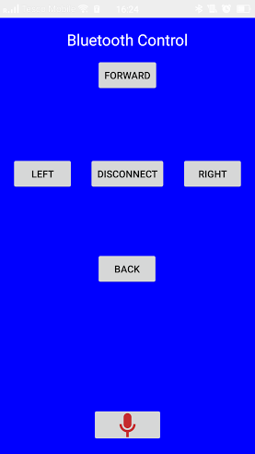
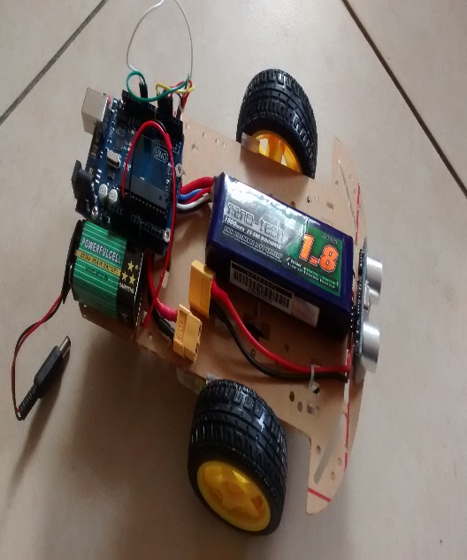
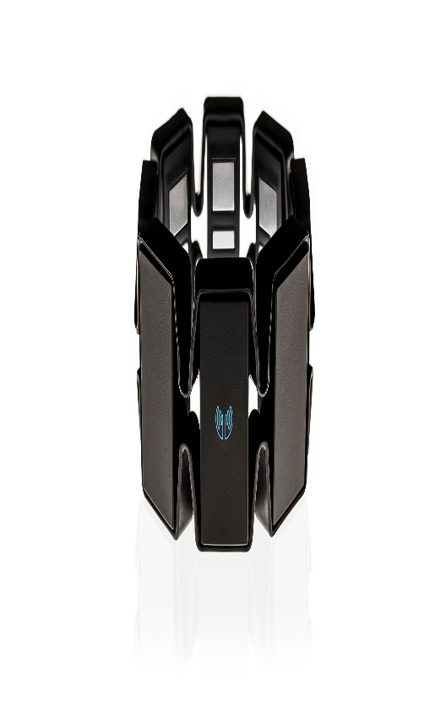
ARCHITECTURE
Robot
Andrino
nRF UART
Wire

Slide 7
CONCLUSION
By the end of this project. We learned that gesture control can be quiet complex to implement, specially when you are dealing with electronic components.
We learned how to communicate from mobile devices to a remote Bluetooth chip to send and receive data to control the movement of our robot.
We learned how to simultaneously communicate to Robot via wire/Bluetooth chip and also via speech recognition from android platform.

